Slide 1
Lecture Notes: Image Histograms

Slide 2
Image Histograms
The histogram of an image is a tally of the number of pixels at each intensity level or color. The shape of the histogram is related to the ranges and groupings of intensity values in the image.
In the following monochrome examples notice how the peaks of in the histogram correspond to concentrations of intensities in the image globally.
In the color examples the primary that has the largest value at any intensity dominates the image.

Slide 3
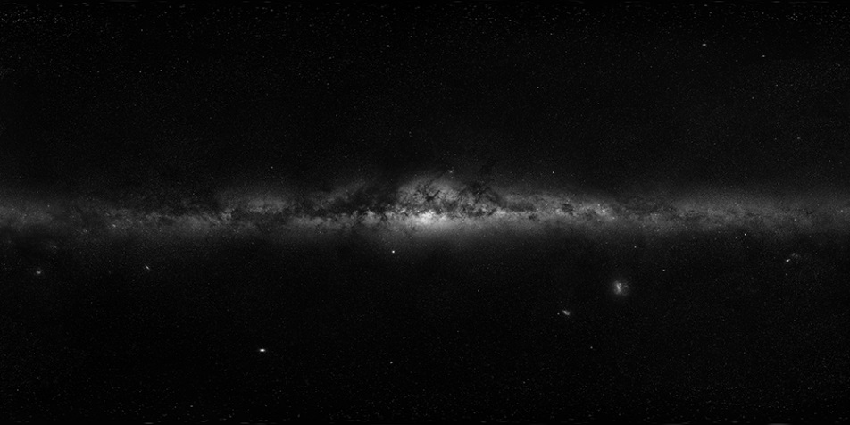
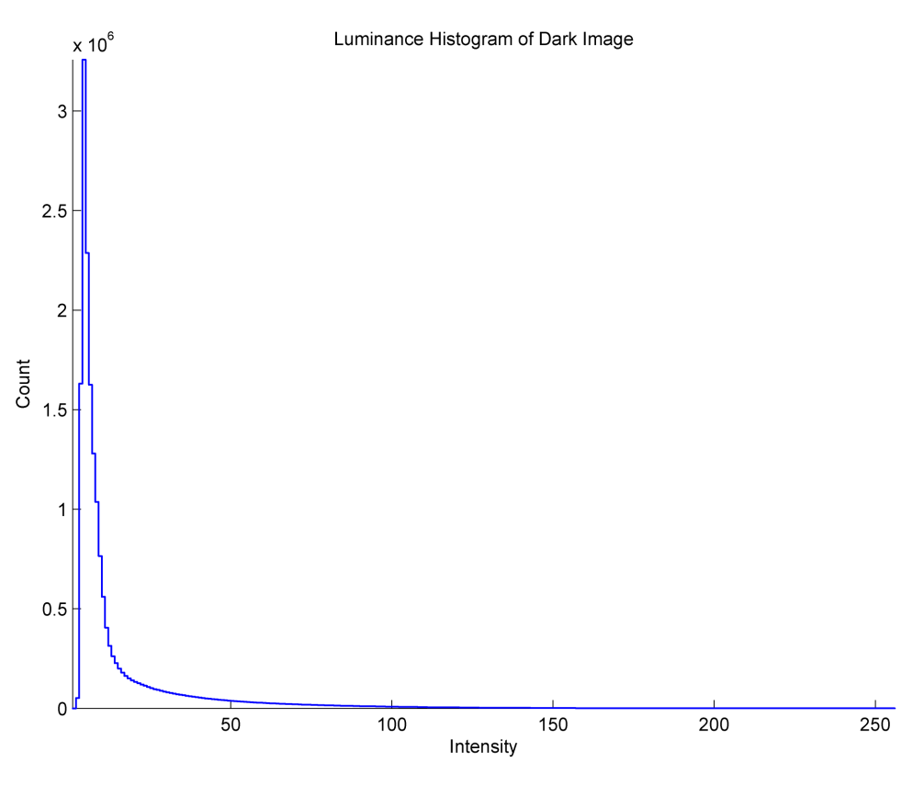
Monochrome Intensity Distributions
This image is a small, monochrome version of a huge color mosaic made by the ESO¹. It contains both celestial hemispheres; it is what you would see in 360° from empty space in the plane of the galaxy above or below the earth.
¹The Euopean Southern Observatory in the Atacama desert of Chile, http://www.eso.org/public/usa/images/eso0932a/

Slide 4
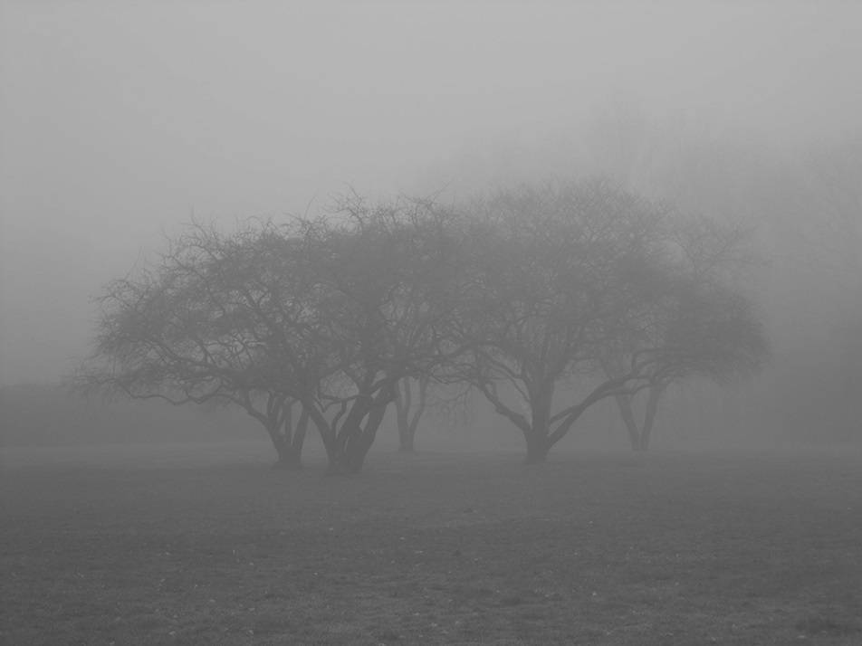
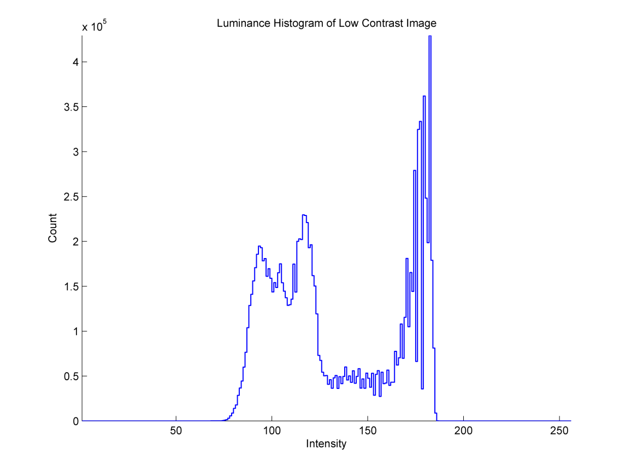
Monochrome Intensity Distributions
This picture, taken in the morning fog, displays low contrast – a narrow range of intensities – with energy at the extremes.
Photographer unknown, downloaded from http://hqwallbase.com/21961-trees-fog-wallpaper-[2]/

Slide 5
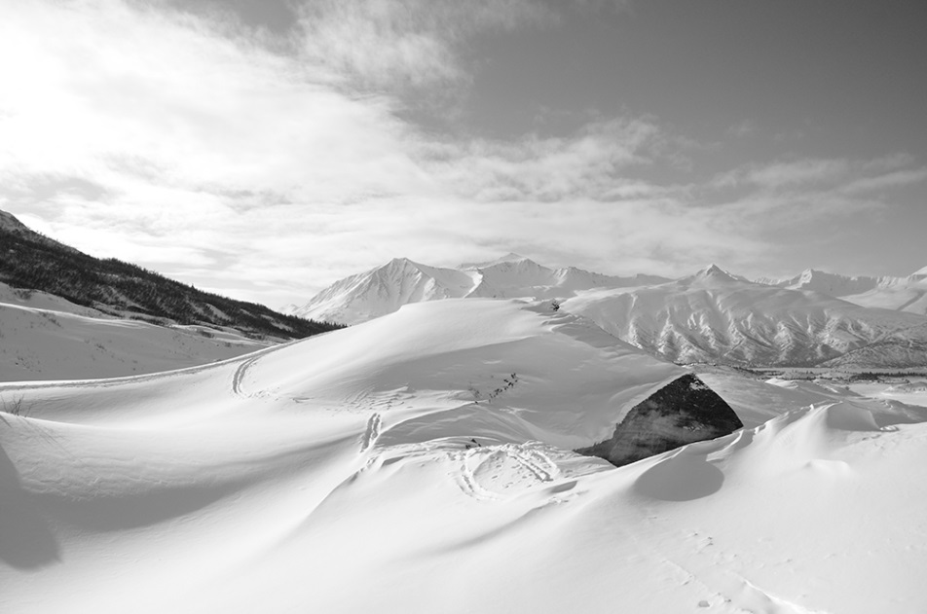
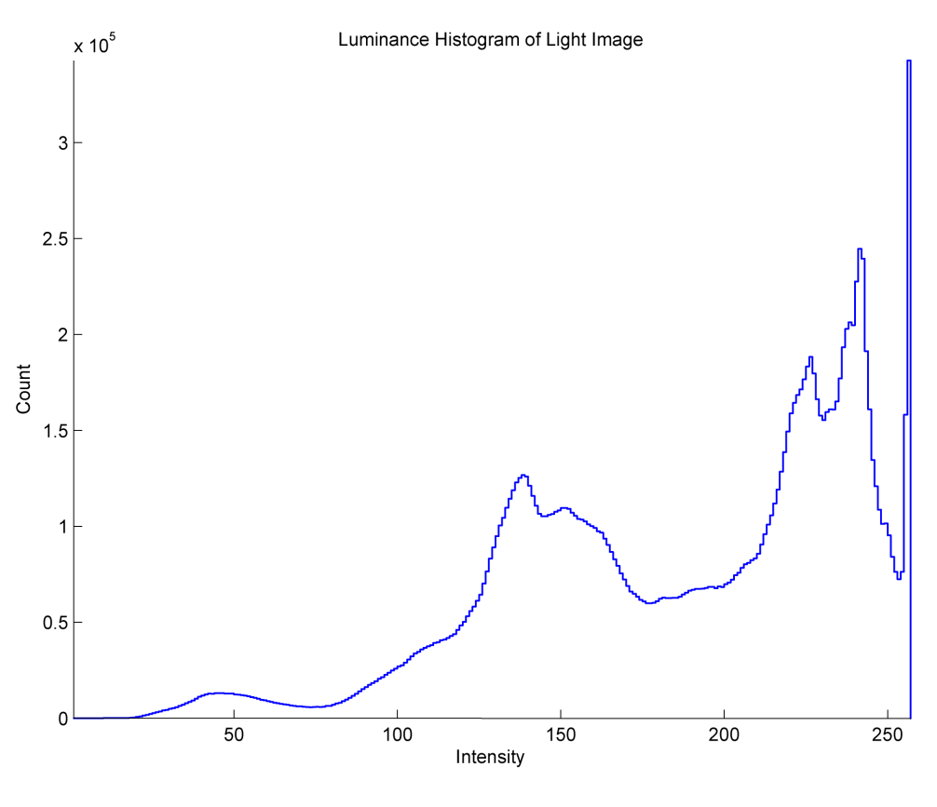
Monochrome Intensity Distributions
Castner glacier in the Delta mountains, Alaska. Monochrome extracted from original color image. Note how the peaks in the histogram correspond to regions in the image.
Photographer unknown, downloaded from https://contest.thesca.org/snow2012/zig-zags-snow

Slide 6
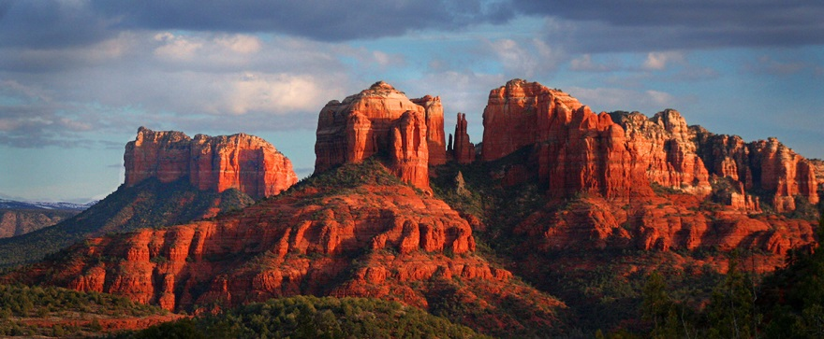
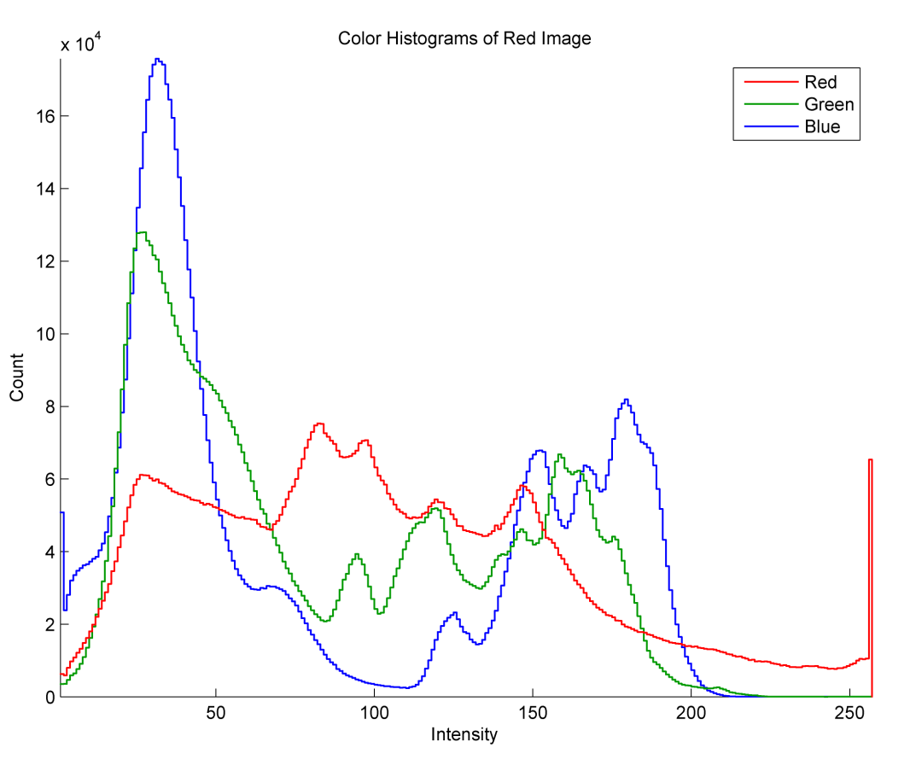
Color Intensity Distributions
Castle Rock, Sedona, Arizona. There is one histogram for each of red, green, and blue. The red rock’s color is in the midrange of intensities while the greenery is darker. Blue peaks corres-pond to the haze on the mountainside (dark) and the sky (bright).
Photo by Edward Chavez, http://www.zensoulstyle.com

Slide 7
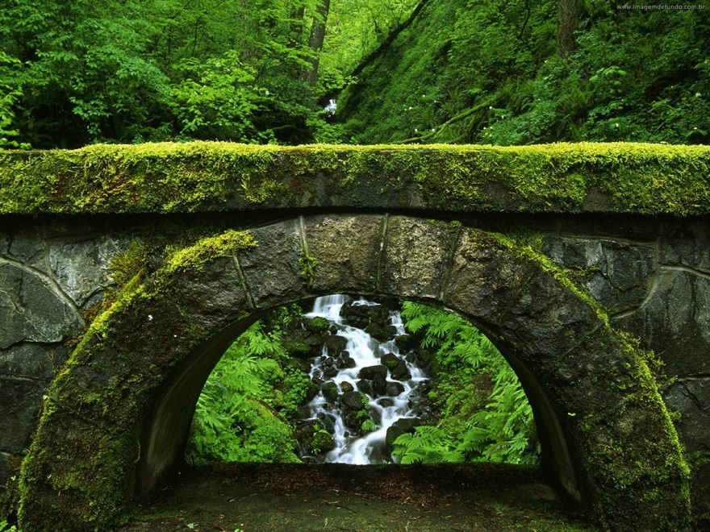
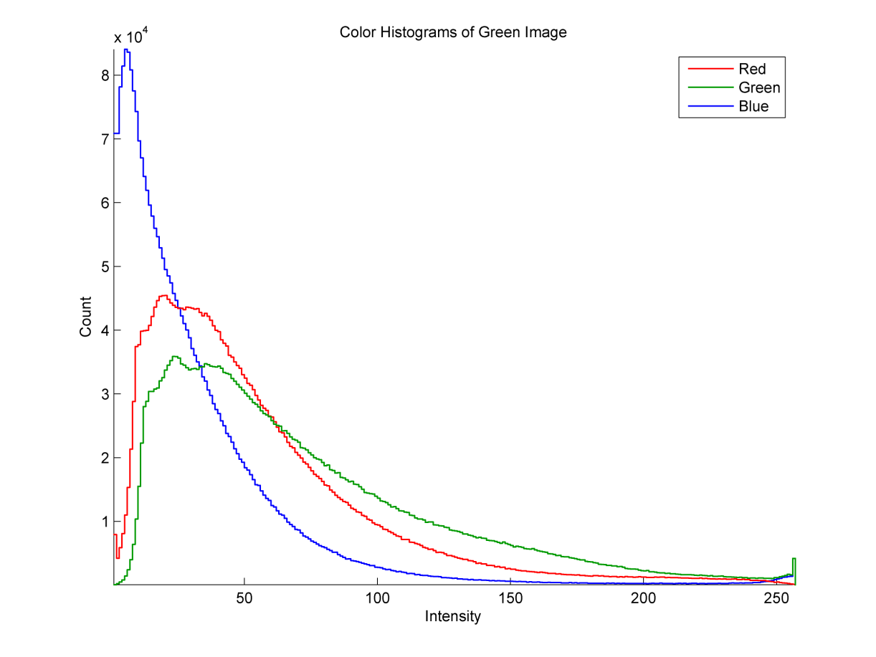
Color Intensity Distributions
Unidentified place in a photo from the website below. Notice that the intensity of green dominates the others over much of the range. Red dominant corresponds to yellow-green regions. Blue dominates in the shadows.
Photographer Unknown, downloaded from http://forum.baboo.com.br/index.php?/gallery/image/20033-floresta-80/

Slide 8
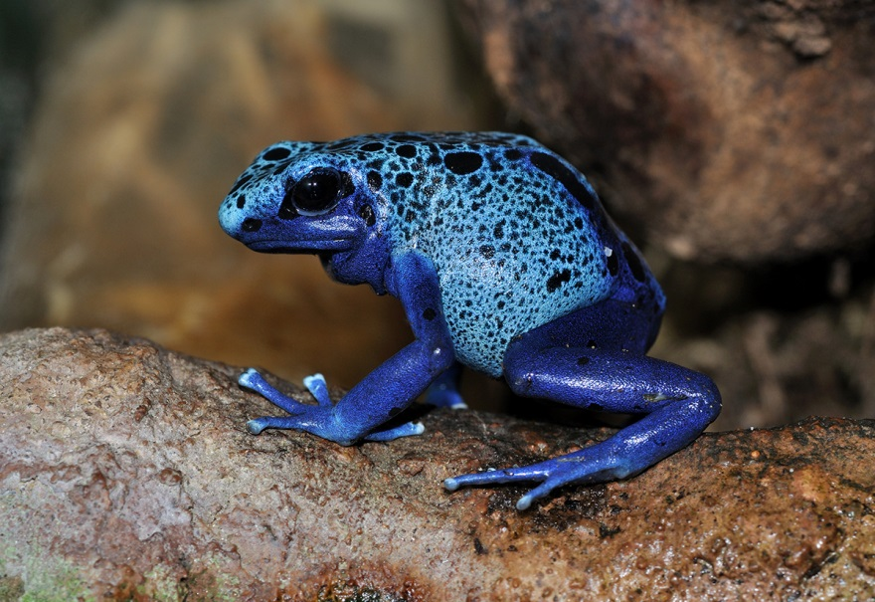
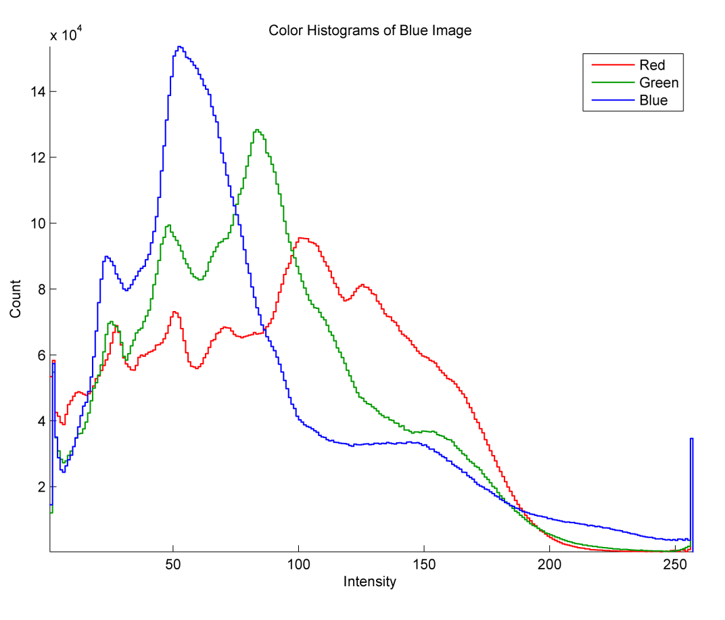
Color Intensity Distributions
Blue Poison Dart Frog (Dendrobates azureus) in the Frankfurt Zoo, Germany. Dominant colors in increasing intensity: brown, blue, tan brown, blue.
Photo by Wikipedia user, Quartl: http://en.wikipedia.org/wiki/File:Dendrobates_azureus_qtl1.jpg/ .

Slide 9
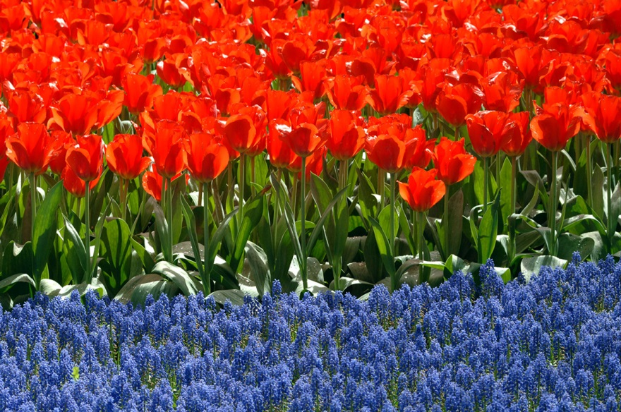
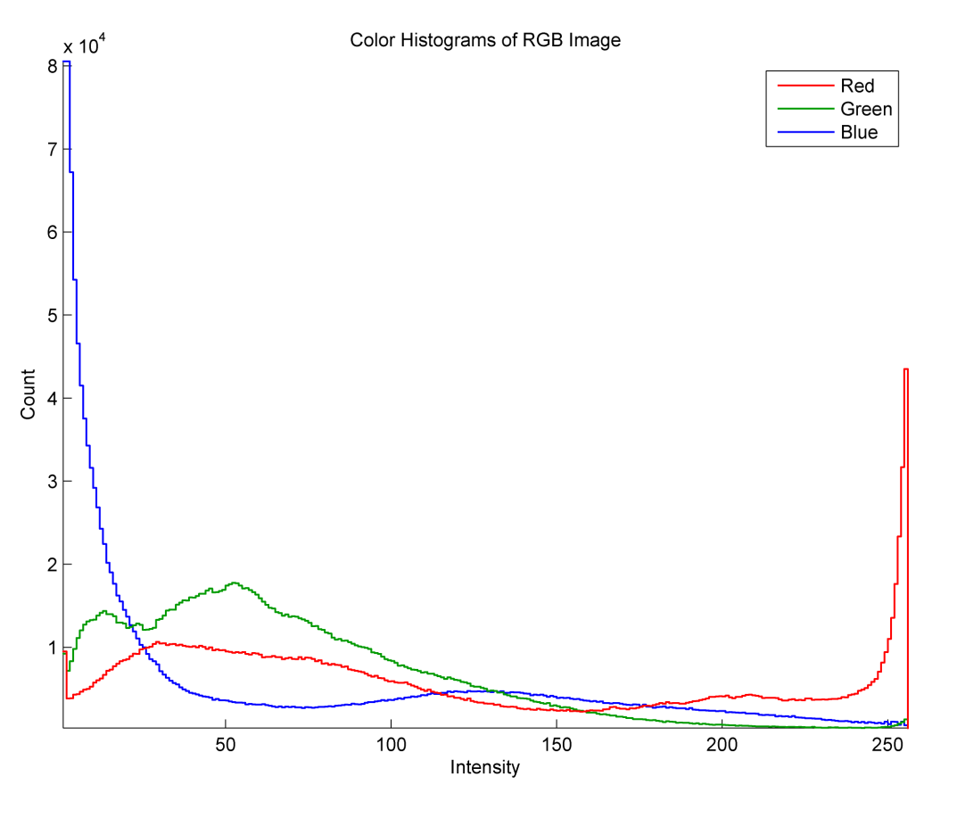
Color Intensity Distributions
Photo taken in the gardens at Keukenhof, Holland, The Netherlands. RGB primaries dominant at different intensities: blue shadows, green tulip stems, blue hyacinths, red tulip flowers.
Photo by Jim Pyre: http://thedude.com/archives/2005/04/amsterdam.html

Slide 10
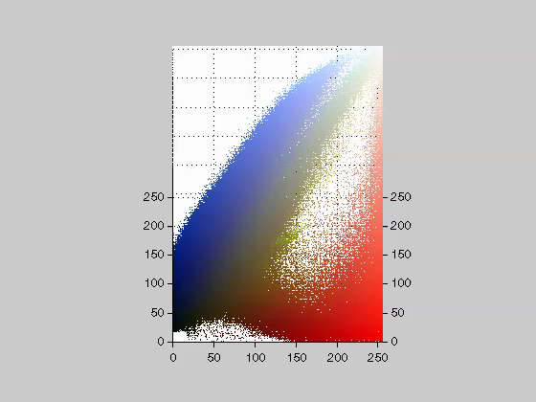
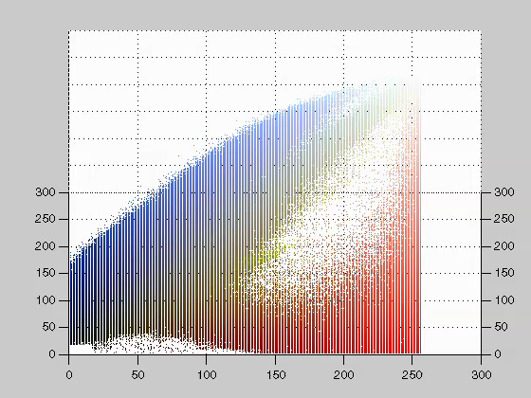
Color Distributions
The video, ColorHistogram3D_c.mp4, goes here.
Notice the Necker cube illusion¹ as the virtual cube rotates.
The video is a 3D true histogram (unique index for 1 RGB 3-tuple / color) of the image. The color of each occupied voxel corresponds to a color in the image. This is for visuali-zation only. The actual 3D histogram contains scalar counts of the colors at each location.
¹ http://en.wikipedia.org/wiki/Necker_cube

Slide 11
Image Histograms: Monochrome
The histogram of an image is a tally of the number of pixels at each intensity level or color. For a monochrome image G,
The value of the histogram at g is the number of pixels for which image G has intensity level g. For an 8-bit image, H has 256 values
If G is an R× C image and all its pixels have the same intensity, g₀, then H(g₀) = RC and H(g) = 0 for all intensities g ≠ g₀.

Slide 12
Image Histograms: Monochrome
If I is a 1-band (monochrome) image, then
the pixel I(r,c) is an 8-bit integer between 0 and 255.
The histogram, h_{I}, of I is:
a 256-element array, h_{I}, where
h_{I}(g) is an integer for g = 1, 2, 3, …, 256, such that
h_{I}(g) = number of pixels in I that have value g-1.
In Matlab an array of length n has indices from 1 to n. In many computer languages, e.g. “C” or “C++” an n-element array is indexed from 0 to n-1.

Slide 13
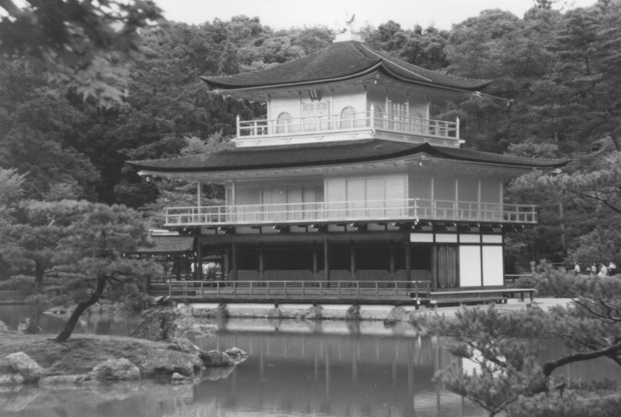
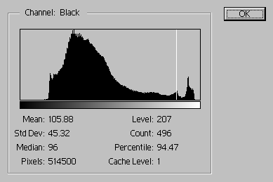
The Histogram of a Monochrome Image
h_{I} (g+1) = the number of pixels in I with intensity level, g.
Luminosity

Slide 14
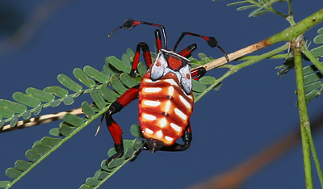
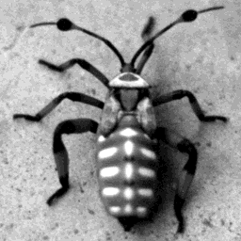
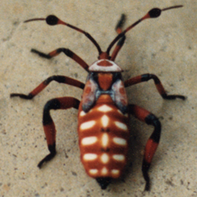
Giant Mesquite Bug
a.k.a. Banjo Beetle
During early summer in the Sonoran Desert of Southern Arizona, clusters of large, strange-looking, red and white bugs can be spotted on the foliage of mesquite trees (Prosopis spp.). These colorful bugs are the immature, wingless nymphs of the Giant Mesquite Bug or Leaf-footed Bug (Thasus neocalifornicus).
24-bit truecolor image
Photo by Alan Peters, Tucson, Arizona 1986.
Photo and description by T. Beth Kinsey http://fireflyforest.net, 2008

Slide 15
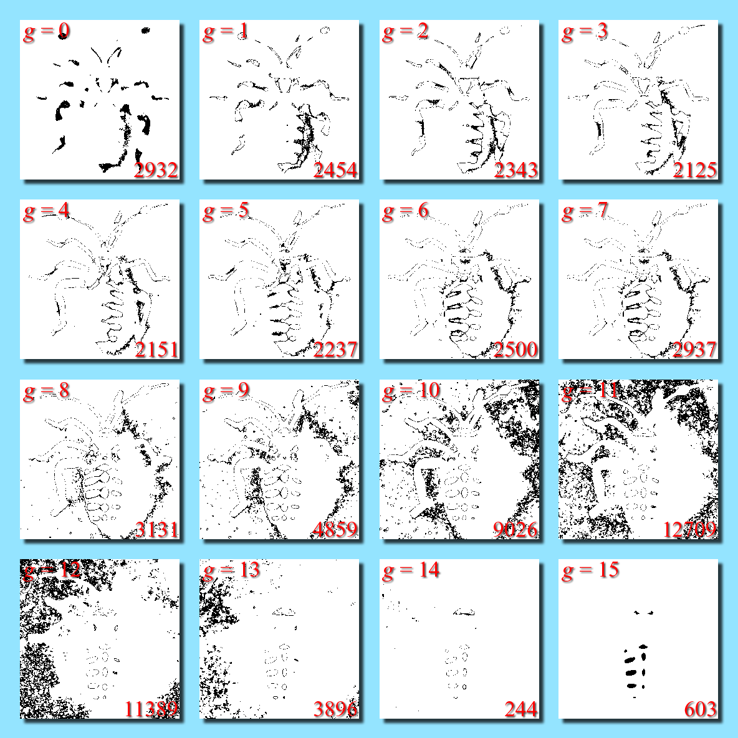
The Histogram of a Monochrome Image
lower RHC: number of pixels with intensity g
black marks pixels with intensity g
16-level (4-bit) image

Slide 16
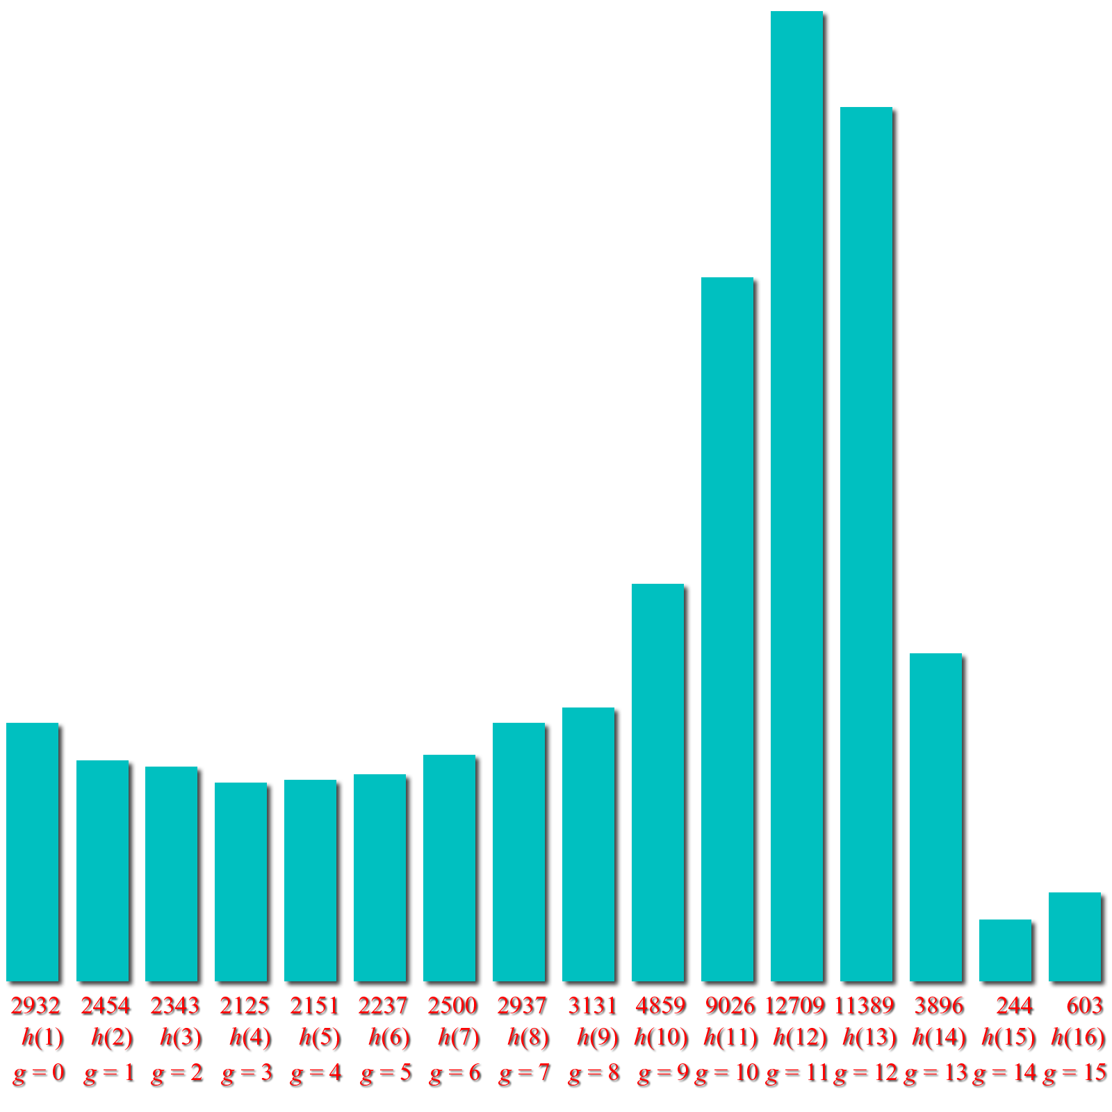
The Histogram of a Monochrome Image
Black marks pixels with intensity g
Plot of histogram:
number of pixels with intensity g

Slide 17
The Histogram of a Monochrome Image
Black marks pixels with intensity g
Plot of histogram:
number of pixels with intensity g

Slide 18
The Histograms of a Color Image
If I is a 3-band image (truecolor, 24-bit)
then I(r,c,b) is an integer between 0 and 255.
Either I has 3 histograms:
h_{R}( g +1) = # of pixels in I(:,:,1) with red intensity value g
h_{G}( g +1) = # of pixels in I(:,:,2) with green intensity value g
h_{B}( g +1) = # of pixels in I(:,:,3) with blue intensity value g
or 1 vector-valued histogram, h(g+1,1,b) where
h( g +1,1,1) = # of pixels in I with red intensity value g
h( g +1,1,2) = # of pixels in I with green intensity value g
h( g +1,1,3) = # of pixels in I with blue intensity value g

Slide 19
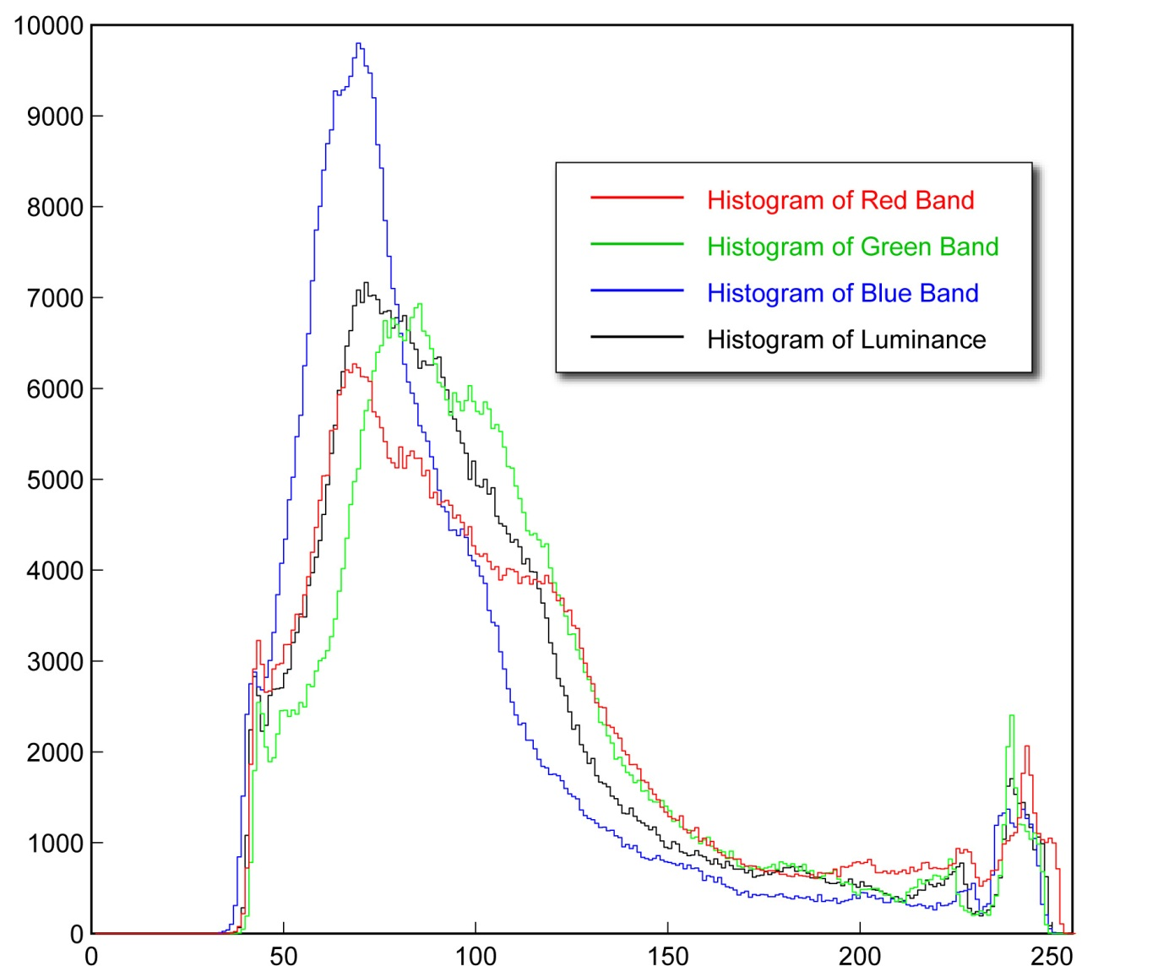
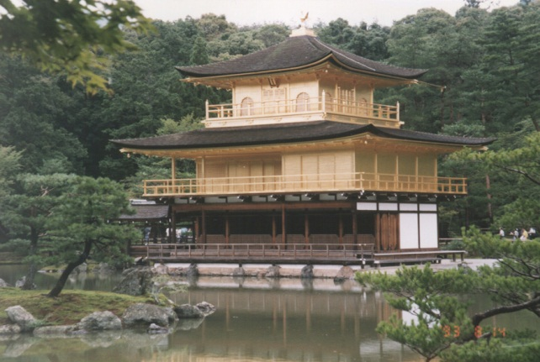
The Histograms of a Color Image

Slide 20
Value Image
How to extract a monochrome intensity image from a color image.
If I is an rgb image, then I’s value image, V, has one band that is the pixel-wise average of I’s R, G, & B bands:
This is easily computed in Matlab by
V=sum(I,3)/3;
The 3 in the 2nd argument of sum tells it to act along dimension 3 of the image – across the color bands.

Slide 21
Luminance Image
How to extract a monochrome intensity image from a color image.
I’s luminance image, L, is a 1-band image that is a specific, weighted, pixel-wise average of I’s R, G, and B bands:
The numbers were derived by the NTSC¹ to weight each color band according to the relative intensity resolution that color by the human eye. The following Matlab code will compute it (very quickly)
L = uint8(sum(bsxfun(@times,double(I),...
reshape([0.299 0.587 0.114],[1 1 3])),3));
but it is not obvious how it does. That is explained on the next slide.
¹ National Television System Committee, 1953, http://en.wikipedia.org/wiki/NTSC

Slide 22
Computing the Luminance Image in Matlab
The first steps are to create a 1 × 1 × 3 matrix (vector) containing the weights
w = reshape([0.299 0.587 0.114],[1 1 3]);
and to convert the uint8, 3-band image, I, to class double,
J = double(I);
bsxfun combines image J and vector w using @times, a multiplication operator. Effectively, it makes an image, W, the same size as J with a copy of w in every pixel location. Then it multiplies the 2 images together pointwise.
T = bsxfun(@times,J,w);
T has bands 0.299R, 0.587G, and 0.144B, which are then summed and converted (rounded) to class uint8.
All the steps are combined into 1 line of code on the previous page.
L = uint8(sum(T,3));

Slide 23

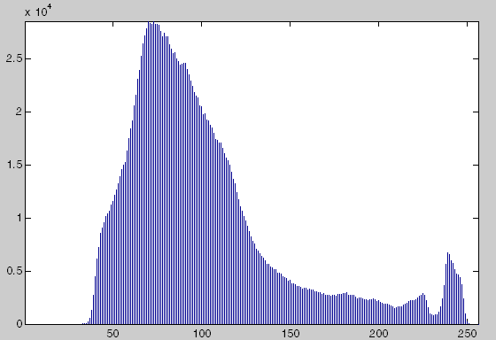
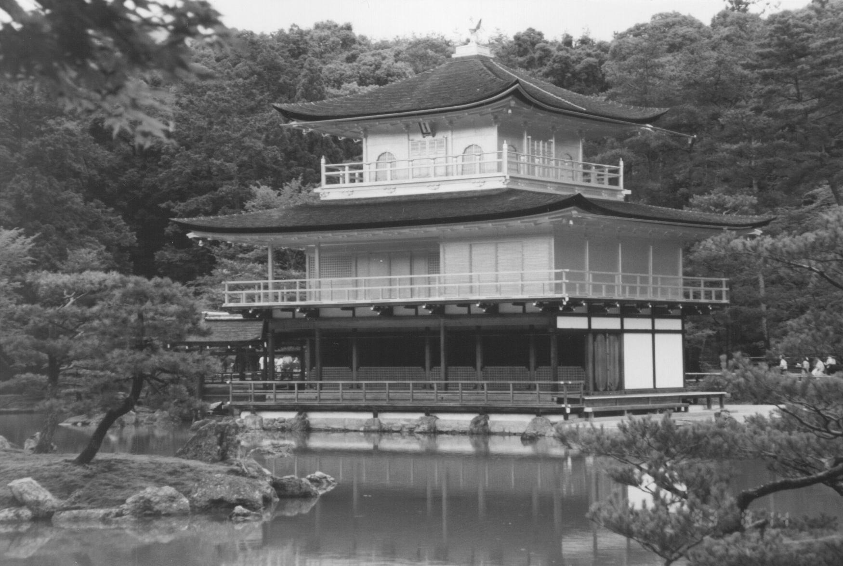
Value Histogram
Value image, V.
Histogram of the value image.

Slide 24
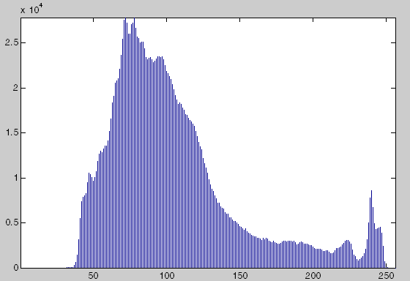

Luminance Histogram
Luminance image, L.
Histogram of the luminance image.

Slide 25
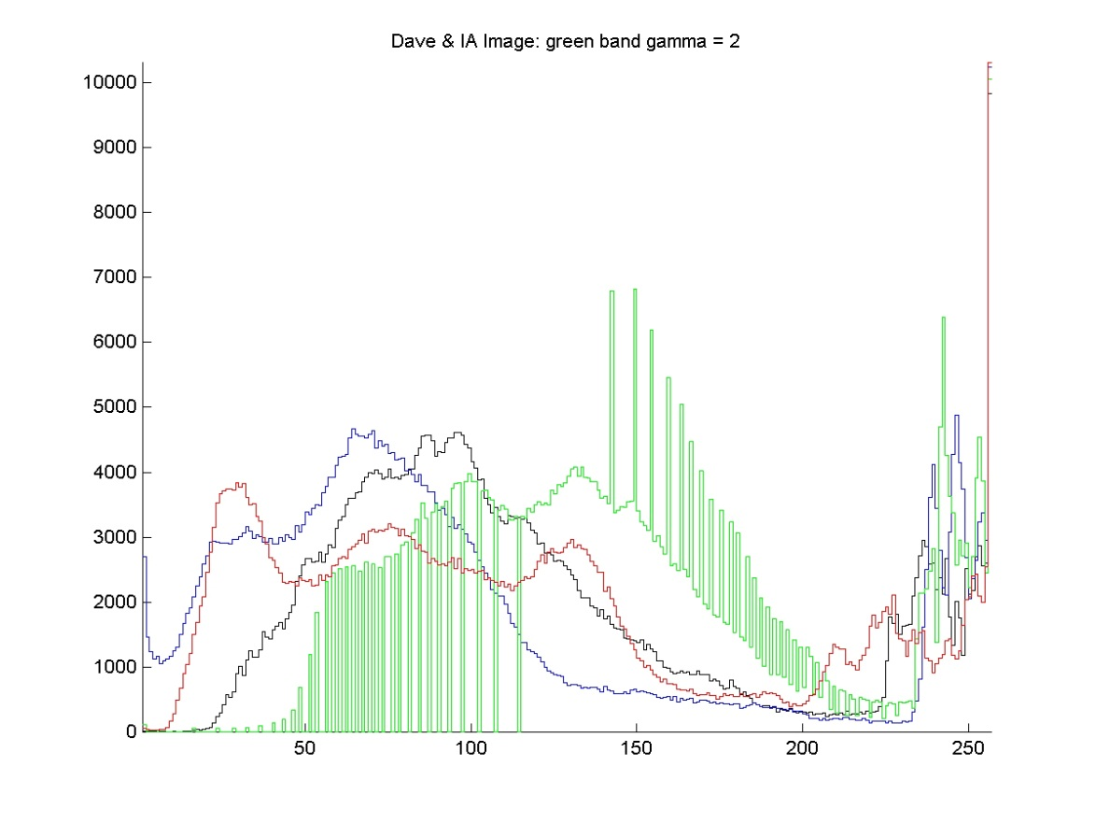
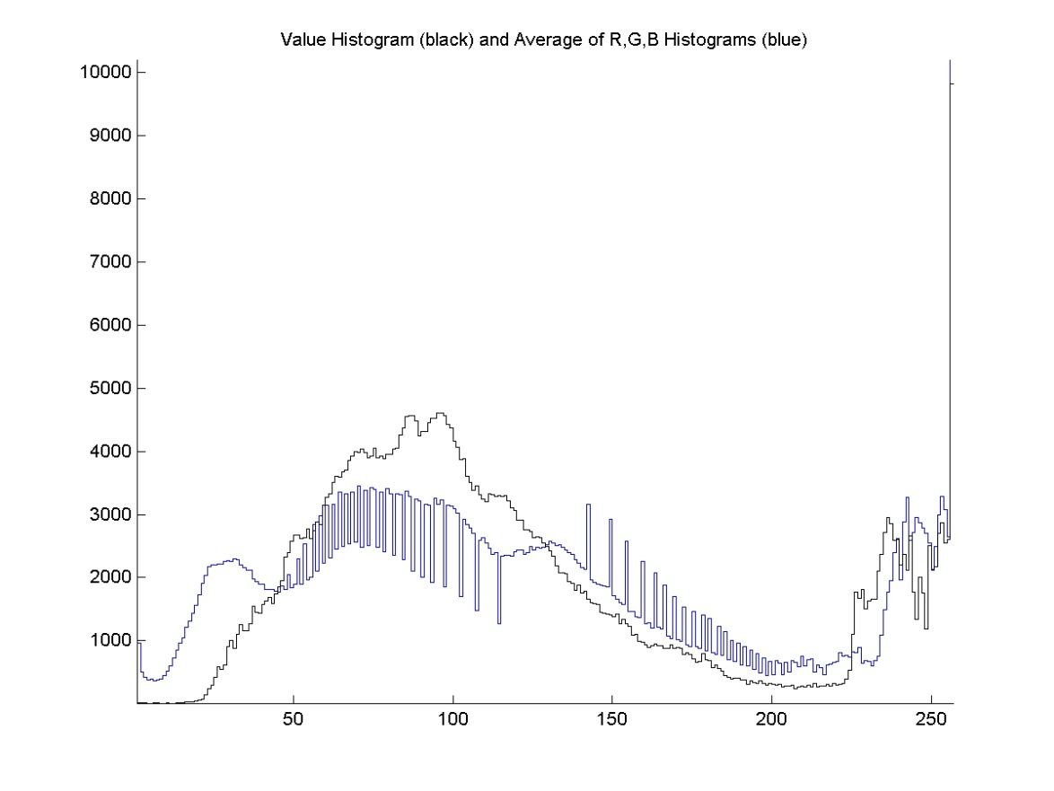
Value Histogram vs. Average of R,G,&B Histograms
The value histogram is not the average of the three 1-D color intensity histograms.
R,G,B,&V histograms
V & avg. of R,G,&B histograms

Slide 26
Multi-Band Histogram Calculator in Matlab
% Multi-band histogram calculator
function h=histogram(I)
[R C B]=size(I);
% allocate the histogram
h=zeros(256,1,B);
% range through the intensity values
for g=0:255
h(g+1,1,:) = sum(sum(I==g)); % accumulate
end
return;
This is an old, slow version. See pp 28-29.

Slide 27
Multi-Band Histogram Calculator in Matlab
% Multi-band histogram calculator
function h=histogram(I)
[R C B]=size(I);
% allocate the histogram
h=zeros(256,1,B);
% range through the intensity values
for g=0:255
h(g+1,1,:) = sum(sum(I==g)); % accumulate
end
return;
Loop through all intensity levels (0-255)
Tag the elements that have value g.
The result is an RxCxB logical array that has a 1 wherever I(r,c,b) = g and 0’s everywhere else.
Compute the number of ones in each band of the image for intensity g.
Store that value in the 256x1xB histogram at h(g+1,1,b).
sum(sum(I==g)) computes one number for each band in the image.
If B==3, then h(g+1,1,:) contains 3 numbers: the number of pixels in bands 1, 2, & 3 that have intensity g.

Slide 28
Vectorized Single-Band Histogram Calculator
% Vectorized single-band histogram calculator using % Matlab’s built-in histogram calculator, histcounts().
% Result, h, is 256×1 for a one-band, uint8 image.
function h = histogram(I)
h = histcounts(I,(0:256))’;
end;
(0:256) are the bin boundaries. # of pixels < 1 is in the 1st bin. # of pixels ≥ 255 & < 256 are in the last bin
histcounts is a new function in version 2014b of Matalab

Slide 29
Vectorized Multi-Band Histogram Calculator
% Vectorized multi-band histogram calculator using % Matlab’s built-in histogram calculator, histcounts().
% Result, h, is 256×1 for a one-band image and 256×1×3 % for a three-band, uint8 image.
function h = histogram(I)
[~,~,B] = size(I);
h = zeros(256,1,B);
for b = 1:B
h(:,1,b) = histcounts(I(:,:,b),[0:256])’;
end;
end;

Slide 30

The Probability Density Function of an Image
pdf
[lower case]
This is the probability that an arbitrary pixel from I_{k} has value g.

Slide 31
The Probability Density Function of an Image
p_{band}(g+1) is the fraction of pixels in (a specific band of) an image that have intensity value g.
p_{band}(g+1) is the probability that a pixel randomly selected from the given band has intensity value g.
Whereas the sum of the histogram h_{band}(g+1) over all g from 1 to 256 is equal to the number of pixels in the image, the sum of p_{band}(g+1) over all g is 1.
p_{band} is the normalized histogram of the band.

Slide 32
The Probability Distribution Function of an Image
Let q = [q₁ q₂ q₃] = I(r,c) be the value of a randomly selected pixel from I. Let g be a specific graylevel. The probability that q_{k} ≤ g is given by
PDF
[upper case]
where h_{Ik}(γ +1) is the histogram of the kth band of I.
This is the probability that any given pixel from I_{k} has value less than or equal to g.

Slide 33
The Probability Distribution Function of an Image
Let q = [q₁ q₂ q₃] = I(r,c) be the value of a randomly selected pixel from I. Let g be a specific graylevel. The probability that q_{k} ≤ g is given by
Also called CDF for “Cumulative Distribution Function”.
where h_{Ik}(γ +1) is the histogram of the kth band of I.
This is the probability that any given pixel from I_{k} has value less than or equal to g.

Slide 34
The Cumulative Distribution Function of an Image
P_{band}(g+1) is the fraction of pixels in (a specific band of) an image that have intensity values less than or equal to g.
P_{band}(g+1) is the probability that a pixel randomly selected from the given band has an intensity value less than or equal to g.
P_{band}(g+1) is the cumulative (or running) sum of p_{band}(g+1) from 0 through g inclusive.
P_{band}(1) = p_{band}(1) and P_{band}(256) = 1; P_{band}(g+1) is nondecreasing.
Note: the Probability Distribution Function (PDF, capital letters) and the Cumulative Distribution Function (CDF) are exactly the same things. Both PDF and CDF will refer to it. However, pdf (small letters) is the density function.

Slide 35
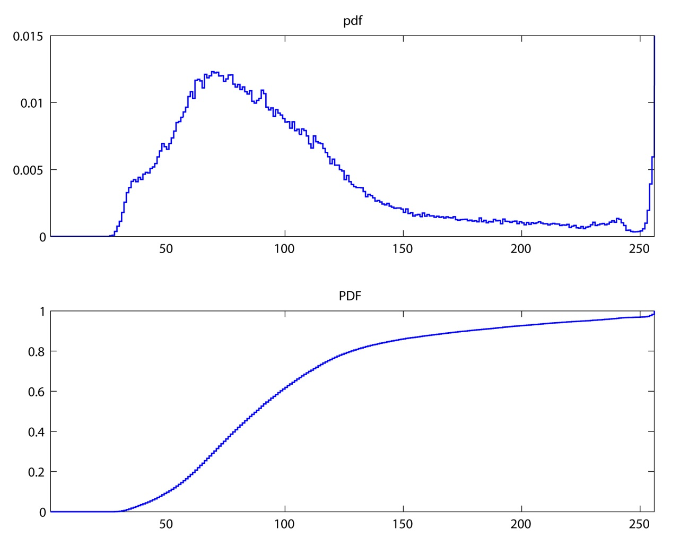

The pdf vs. the CDF
pdf = backward difference of CDF.
CDF = running sum of pdf.

Slide 36
Simple Matlab Code for 1-Band Images
% Matlab code for histogram (h), pdf (p), and CDF (C)
% of a 1-band image, I.
% I’s 256-bin histogram
h = histcounts(I,[0:256])’;
% I’s pixel-intensity probability density function
p = h/length(I(:));
% I’s pixel-intensity cumulative distribution function
C = cumsum(p);

Slide 37
Code for Histograms of 3-Band Images
% Matlab code for red, green, blue, value, and luminance
% histograms of a 3-band image, I.
hr = histcounts(I(:,:,1),[0:256])’; % red-band histogram
hg = histcounts(I(:,:,2),[0:256])’; % green-band histogram
hb = histcounts(I(:,:,3),[0:256])’; % blue-band histogram
V = uint8(sum(I,3)/3); % value image
hk = histcounts(V,[0:256])’; % value histogram
L = uint8(0.299*I(:,:,1) + ... % luminance image
0.587*I(:,:,2) + 0.114*I(:,:,3);
lk = histcounts(L,[0:256])’; % luminance histogram

Slide 38
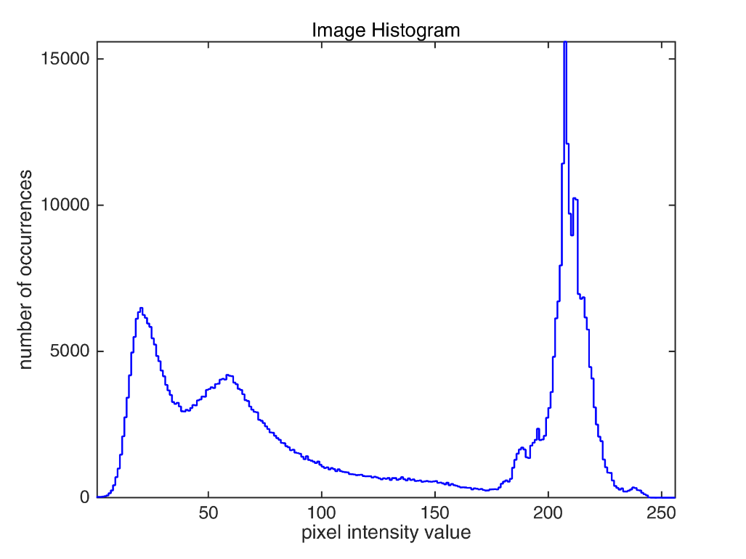
Histogram Shapes
The histogram of a continuous tone image is usually a relatively smooth curve with peaks at the most frequently occurring intensities:

Slide 39
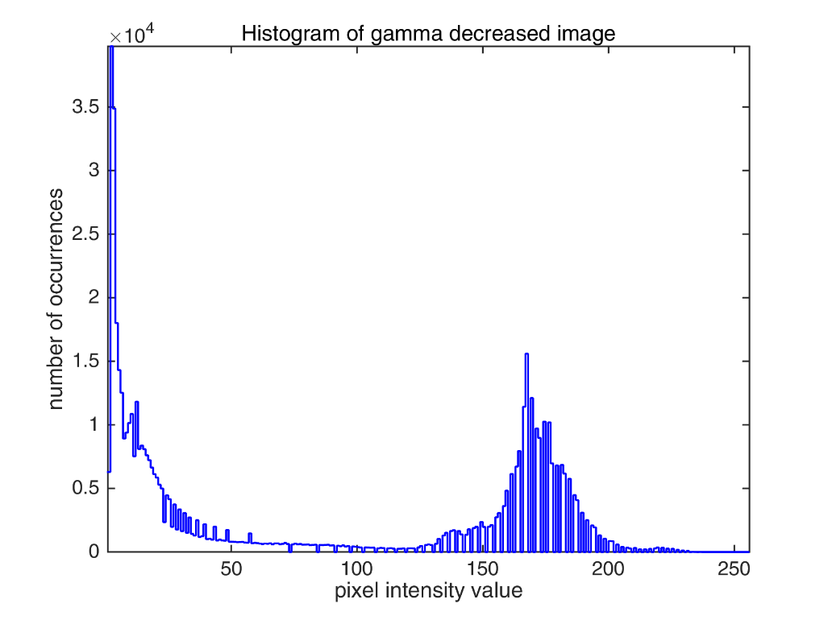
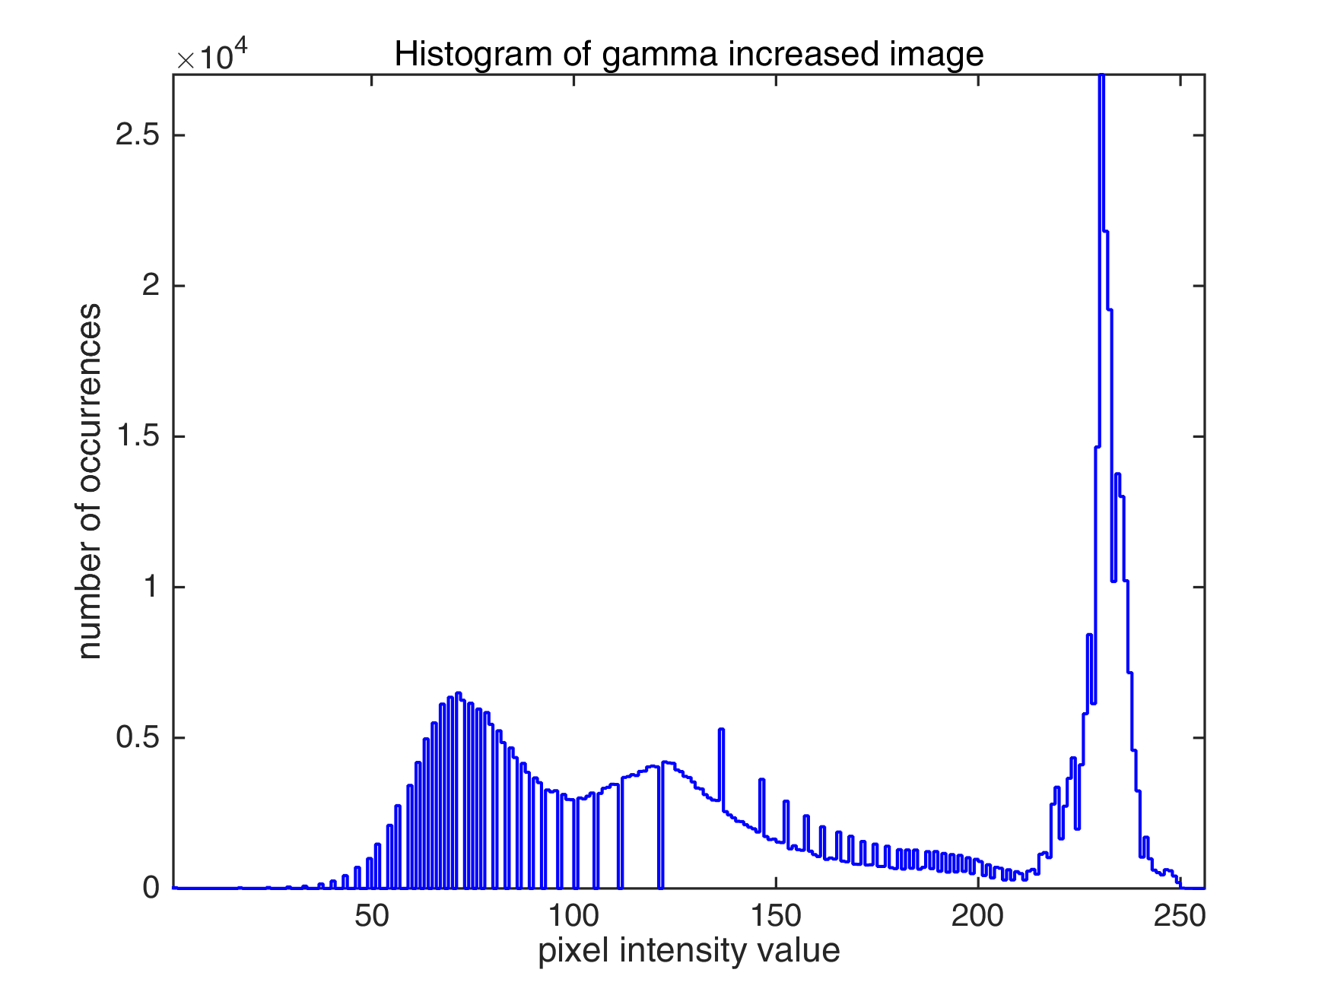
Histogram Shapes
If an image has had its contrast altered, often that can be seen in its histogram.
2 or more intensities mapped to 1
consecutive intensities separated
consecutive intensities separated
2 or more intensities mapped to 1

